Slide 1
Tesseract Trading Platform
Tenzing Passang, Junde Lin, Kewin Li

Slide 2
Team Members
Tenzing Passang
Architectural Design
Database Schema Design
JPA/Persistence
Junde Lin
User Interface Design (HTML, CSS, JavaScript, JQuery, AJAX)
REST Service – JAX-RS
Kewin Li
Trading Algorithm Design (Two Moving Averages) with Multi Threading
Java Messaging Services

Slide 3
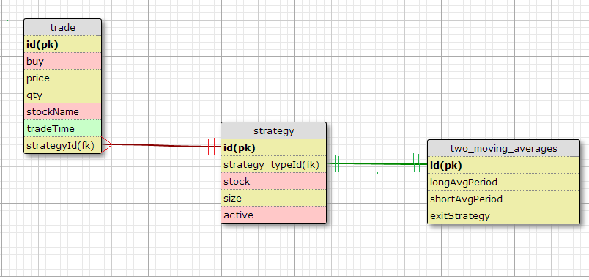
Database Schema

Slide 4
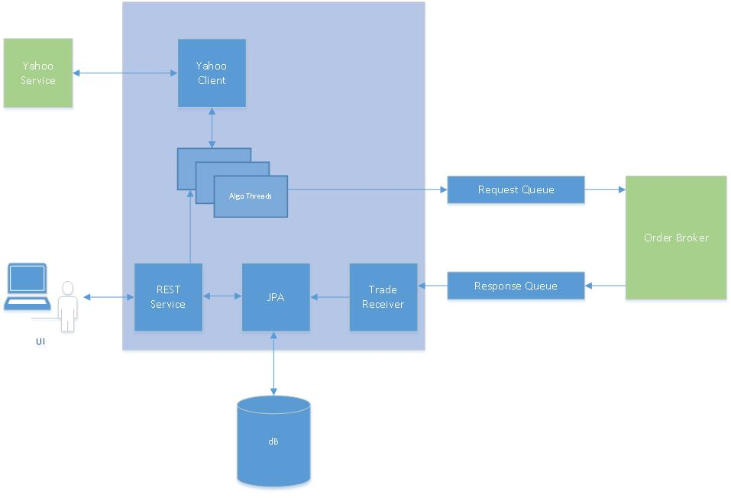
Architecture/Components

Slide 5
Technology Stack
User Interface (UI) – HTML,CSS, JavaScript, JQuery, AJAX
REST Service – JAX-RS
Persistence Entity – JPA
Algorithm – Multiple Java Threads
Yahoo Client – Java HttpURLConnection
Request Queue – JMS ActiveMQ
Trade Receiver – Java ActiveMQ Listener

Slide 6
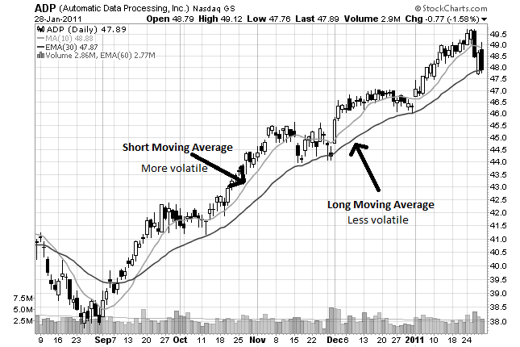
Two-Moving Averages

Slide 7
User Interface
Demo

Slide 8
Run Book
Run ActiveMQ for the queues
Start the derby database
Run the order broker as a java application from the project OrderBroker: src/com.citi.trading.order/OrderBroker.java
Start the QuickfixJ Order Broker Exchange
Start the Listener to Response queue as a java application from the project StockRestService:
Java Resources/src/cc.service/ReceivingTrade.java
Finally, start the WebService and run the ServiceResource.java on the tomcat server. The Service Resource is on the project StockRestService/ Java Resources/src/cc.service/ServiceResource.java
Open http://localhost:8080/StockRestService/login.html for the UI.

